Slide 1

DIVINE GRACE COLLEGE OF ARTS, SCIENCE AND TECHNOLOGY
(DGCAST) — GAROUA | GEOGRAPHY DEPARTMENT
UPPER SIXTH ARTS — POPULATION GEOGRAPHY — LESSON 9
Population Growth and its Determinants
Mr KAMDEM EMMANUEL
Geography Teacher — PLEG
Academic Year 2026 / 2027
Notes:
Good morning, class. Today we study Lesson 9: Population Growth and its Determinants.

Slide 2
GEOGRAPHY — UPPER SIXTH ARTS
CLASS INFO
Class, Chapter & Duration
Class | Upper Sixth Arts
Chapter | Module 4: Understanding and managing population dynamics across the world in general and Cameroon in particular
Duration | 2 periods (2 × 50 minutes)
2026 / 2027
DGCAST GAROUA — GEOGRAPHY DEPARTMENT
Mr KAMDEM E. | 2

Slide 3
GEOGRAPHY — UPPER SIXTH ARTS
IDENTIFICATION
Lesson Identification
Topic | Population Change over Time (Population Growth)
Sub-topic | Population Growth
Lesson | Lesson 9: Population Growth and its Determinants
Notions / Concepts | Positive growth, zero growth, negative growth, natural increase, fertility, mortality, net migration.
Syllabus focus | Meaning of positive, negative and zero growth; the population change system; determinants (fertility, mortality, migration) and their spatial differences.
Competence | Learners are able to explain how births, deaths and migration change population.
2026 / 2027
DGCAST GAROUA — GEOGRAPHY DEPARTMENT
Mr KAMDEM E. | 3

Slide 4
GEOGRAPHY — UPPER SIXTH ARTS
OBJECTIVES
Learning Objectives
By the end of the lesson, the learner should be able to:
Distinguish positive, zero and negative growth.
Describe the population change system.
Compare birth and death rates across the world.
2026 / 2027
DGCAST GAROUA — GEOGRAPHY DEPARTMENT
Mr KAMDEM E. | 4

Slide 5
GEOGRAPHY — UPPER SIXTH ARTS
RECALL
Recall
World population is still growing.
Some countries are losing population.
2026 / 2027
DGCAST GAROUA — GEOGRAPHY DEPARTMENT
Mr KAMDEM E. | 5

Slide 6
GEOGRAPHY — UPPER SIXTH ARTS
REAL-LIFE SITUATION
Real-Life Situation
Niger's population grows by almost 4 % a year, while Japan's falls by about half a percent. Both countries have hospitals and schools. Learners want to know what decides growth.
2026 / 2027
DGCAST GAROUA — GEOGRAPHY DEPARTMENT
Mr KAMDEM E. | 6
Notes:
Read the situation slowly, twice.

Slide 7
GEOGRAPHY — UPPER SIXTH ARTS
REAL-LIFE SITUATION
Situation — Question 1
What is the problem in the situation?
2026 / 2027
DGCAST GAROUA — GEOGRAPHY DEPARTMENT
Mr KAMDEM E. | 7

Slide 8
GEOGRAPHY — UPPER SIXTH ARTS
REAL-LIFE SITUATION
Answer
Countries grow at very different rates.
2026 / 2027
DGCAST GAROUA — GEOGRAPHY DEPARTMENT
Mr KAMDEM E. | 8

Slide 9
GEOGRAPHY — UPPER SIXTH ARTS
REAL-LIFE SITUATION
Situation — Question 2
What three things change population?
2026 / 2027
DGCAST GAROUA — GEOGRAPHY DEPARTMENT
Mr KAMDEM E. | 9

Slide 10
GEOGRAPHY — UPPER SIXTH ARTS
REAL-LIFE SITUATION
Answer
Births, deaths and migration.
2026 / 2027
DGCAST GAROUA — GEOGRAPHY DEPARTMENT
Mr KAMDEM E. | 10

Slide 11
GEOGRAPHY — UPPER SIXTH ARTS
REAL-LIFE SITUATION
Situation — Question 3
What type of growth does Japan have?
2026 / 2027
DGCAST GAROUA — GEOGRAPHY DEPARTMENT
Mr KAMDEM E. | 11

Slide 12
GEOGRAPHY — UPPER SIXTH ARTS
REAL-LIFE SITUATION
Possible Answer
Negative growth.
2026 / 2027
DGCAST GAROUA — GEOGRAPHY DEPARTMENT
Mr KAMDEM E. | 12

Slide 13
GEOGRAPHY — UPPER SIXTH ARTS
JUSTIFICATION
Justification of the Lesson
This lesson helps us to understand what makes a population grow or decline.
2026 / 2027
DGCAST GAROUA — GEOGRAPHY DEPARTMENT
Mr KAMDEM E. | 13

Slide 14
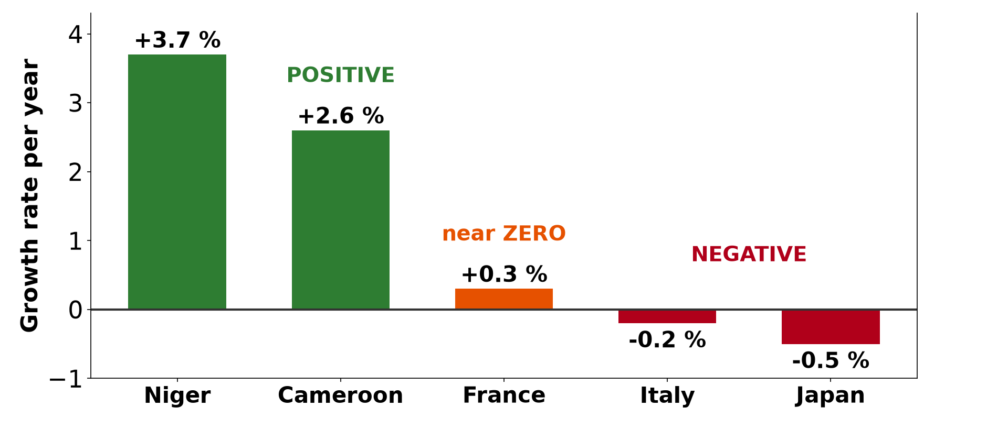
GEOGRAPHY — UPPER SIXTH ARTS
I. TYPES OF GROWTH
Activity 1
Positive, zero and negative growth.
2026 / 2027
DGCAST GAROUA — GEOGRAPHY DEPARTMENT
Mr KAMDEM E. | 14
Notes:
Without the projector: draw the bars.

Slide 15
GEOGRAPHY — UPPER SIXTH ARTS
I. TYPES OF GROWTH
Activity 1: Question
Which countries have negative growth? Why?
2026 / 2027
DGCAST GAROUA — GEOGRAPHY DEPARTMENT
Mr KAMDEM E. | 15

Slide 16
GEOGRAPHY — UPPER SIXTH ARTS
I. TYPES OF GROWTH
Answer
Italy and Japan; deaths are greater than births.
2026 / 2027
DGCAST GAROUA — GEOGRAPHY DEPARTMENT
Mr KAMDEM E. | 16

Slide 17
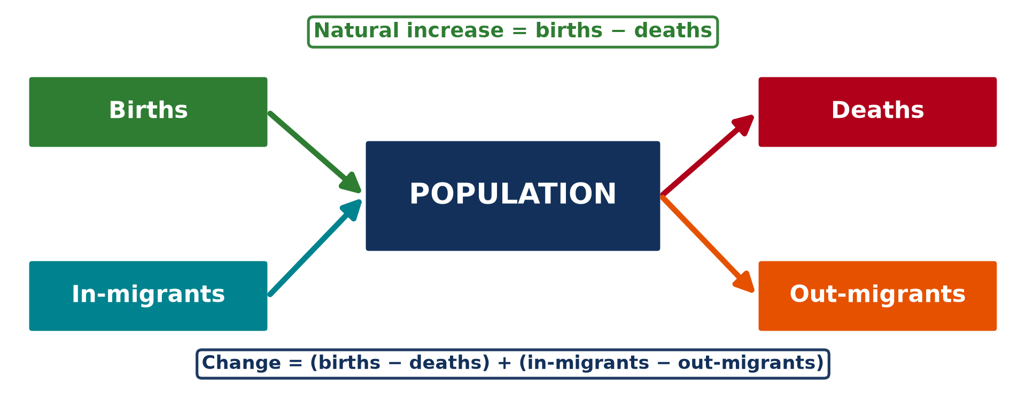
GEOGRAPHY — UPPER SIXTH ARTS
II. THE CHANGE SYSTEM
Activity 2
The population change system.
2026 / 2027
DGCAST GAROUA — GEOGRAPHY DEPARTMENT
Mr KAMDEM E. | 17
Notes:
Without the projector: draw the system.

Slide 18
GEOGRAPHY — UPPER SIXTH ARTS
II. THE CHANGE SYSTEM
Activity 2: Question
Write the formula for population change.
2026 / 2027
DGCAST GAROUA — GEOGRAPHY DEPARTMENT
Mr KAMDEM E. | 18

Slide 19
GEOGRAPHY — UPPER SIXTH ARTS
II. THE CHANGE SYSTEM
Answer
(Births − deaths) + (in-migrants − out-migrants).
2026 / 2027
DGCAST GAROUA — GEOGRAPHY DEPARTMENT
Mr KAMDEM E. | 19

Slide 20
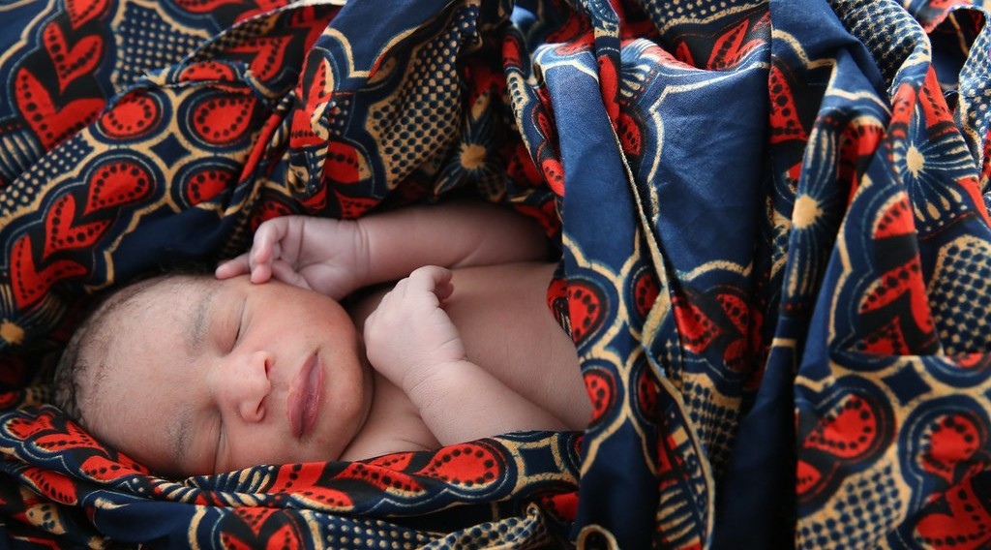
GEOGRAPHY — UPPER SIXTH ARTS
III. FERTILITY
Activity 3
A newborn baby.
2026 / 2027
DGCAST GAROUA — GEOGRAPHY DEPARTMENT
Mr KAMDEM E. | 20
Notes:
Without the projector: discuss family size.

Slide 21
GEOGRAPHY — UPPER SIXTH ARTS
III. FERTILITY
Activity 3: Question
Why are birth rates high in many African countries?
2026 / 2027
DGCAST GAROUA — GEOGRAPHY DEPARTMENT
Mr KAMDEM E. | 21

Slide 22
GEOGRAPHY — UPPER SIXTH ARTS
III. FERTILITY
Answer
Early marriage, children as labour and security, low use of contraception.
2026 / 2027
DGCAST GAROUA — GEOGRAPHY DEPARTMENT
Mr KAMDEM E. | 22

Slide 23
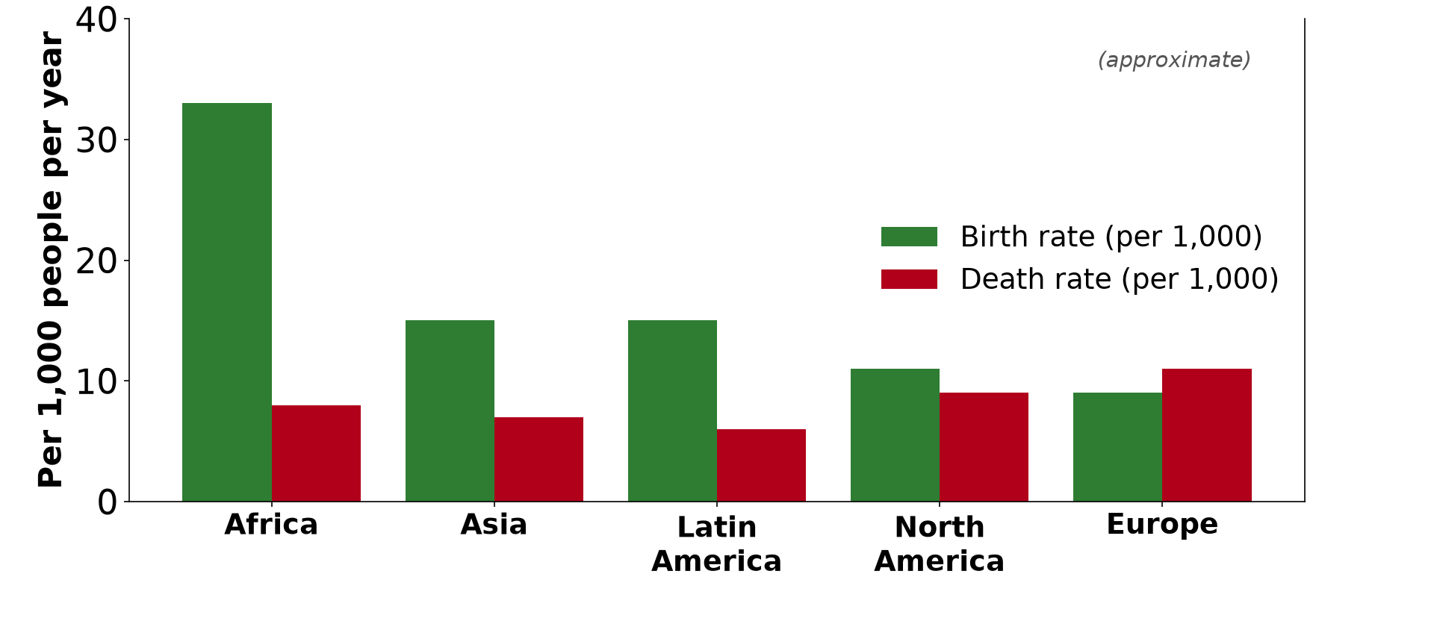
GEOGRAPHY — UPPER SIXTH ARTS
III. SPATIAL DIFFERENCES
Activity 4
Birth and death rates by region (approximate).
2026 / 2027
DGCAST GAROUA — GEOGRAPHY DEPARTMENT
Mr KAMDEM E. | 23
Notes:
Without the projector: compare the bars.

Slide 24
GEOGRAPHY — UPPER SIXTH ARTS
III. SPATIAL DIFFERENCES
Activity 4: Question
Which region has the largest gap between births and deaths?
2026 / 2027
DGCAST GAROUA — GEOGRAPHY DEPARTMENT
Mr KAMDEM E. | 24

Slide 25
GEOGRAPHY — UPPER SIXTH ARTS
III. SPATIAL DIFFERENCES
Answer
Africa (33 and 8 per 1,000).
2026 / 2027
DGCAST GAROUA — GEOGRAPHY DEPARTMENT
Mr KAMDEM E. | 25

Slide 26
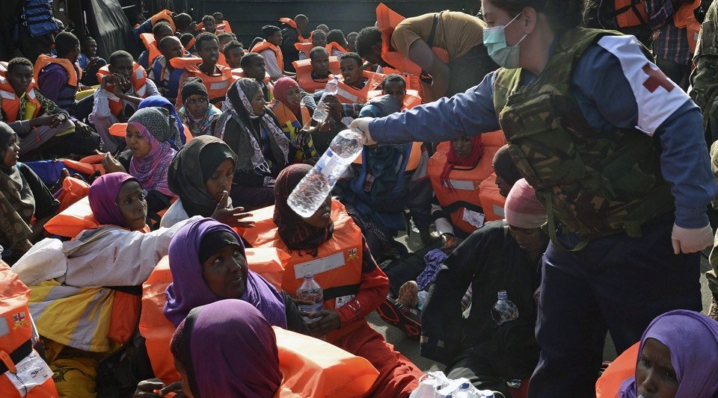
GEOGRAPHY — UPPER SIXTH ARTS
IV. MIGRATION
Activity 5
Migrants rescued at sea.
2026 / 2027
DGCAST GAROUA — GEOGRAPHY DEPARTMENT
Mr KAMDEM E. | 26
Notes:
Without the projector: discuss emigration from Cameroon.

Slide 27
GEOGRAPHY — UPPER SIXTH ARTS
IV. MIGRATION
Activity 5: Question
How can migration change a country's population?
2026 / 2027
DGCAST GAROUA — GEOGRAPHY DEPARTMENT
Mr KAMDEM E. | 27

Slide 28
GEOGRAPHY — UPPER SIXTH ARTS
IV. MIGRATION
Answer
Immigration adds people; emigration removes them.
2026 / 2027
DGCAST GAROUA — GEOGRAPHY DEPARTMENT
Mr KAMDEM E. | 28

Slide 29
GEOGRAPHY — UPPER SIXTH ARTS
BOARD SUMMARY
Population Growth and its Determinants
Topic: Population Change over Time (Population Growth)
Sub-topic: Population Growth
Lesson 9: Population Growth and its Determinants
2026 / 2027
DGCAST GAROUA — GEOGRAPHY DEPARTMENT
Mr KAMDEM E. | 29
Notes:
Learners copy the board summary now. Give them enough time for each slide.

Slide 30
GEOGRAPHY — UPPER SIXTH ARTS
BOARD SUMMARY
I. Definitions
Natural increase: It is the difference between births and deaths.
Fertility: It is the actual number of children born to women.
Mortality: It is the number of deaths in a population.
Net migration: It is in-migrants minus out-migrants.
2026 / 2027
DGCAST GAROUA — GEOGRAPHY DEPARTMENT
Mr KAMDEM E. | 30

Slide 31
GEOGRAPHY — UPPER SIXTH ARTS
BOARD SUMMARY
II. Types of Growth and the System (1/2)
A. Positive growth: Births and in-migration exceed deaths and out-migration. Most LEDCs have positive growth.
B. Zero and negative growth: Zero growth means no change; negative growth means the population falls. Japan and Italy are declining.
2026 / 2027
DGCAST GAROUA — GEOGRAPHY DEPARTMENT
Mr KAMDEM E. | 31

Slide 32
GEOGRAPHY — UPPER SIXTH ARTS
BOARD SUMMARY
II. Types of Growth and the System (2/2)
C. The system: Births and in-migrants are inputs, and deaths and out-migrants are outputs. Population is the store.
2026 / 2027
DGCAST GAROUA — GEOGRAPHY DEPARTMENT
Mr KAMDEM E. | 32

Slide 33
GEOGRAPHY — UPPER SIXTH ARTS
BOARD SUMMARY
III. Determinants and Differences (1/2)
A. Fertility: It is high in Africa (about 33 births per 1,000) and low in Europe (about 9). Culture, education and income explain this.
B. Mortality: Death rates are now low almost everywhere. They are higher in old populations like Europe.
2026 / 2027
DGCAST GAROUA — GEOGRAPHY DEPARTMENT
Mr KAMDEM E. | 33

Slide 34
GEOGRAPHY — UPPER SIXTH ARTS
BOARD SUMMARY
III. Determinants and Differences (2/2)
C. Migration: It adds people to rich countries and removes them from poor ones. It is important in Europe and North America.
2026 / 2027
DGCAST GAROUA — GEOGRAPHY DEPARTMENT
Mr KAMDEM E. | 34

Slide 35
GEOGRAPHY — UPPER SIXTH ARTS
FORMATIVE EVALUATION
Formative Evaluation 1
Write the formula for population change.
2026 / 2027
DGCAST GAROUA — GEOGRAPHY DEPARTMENT
Mr KAMDEM E. | 35

Slide 36
GEOGRAPHY — UPPER SIXTH ARTS
FORMATIVE EVALUATION
Expected Answer
(Births − deaths) + (in-migrants − out-migrants).
2026 / 2027
DGCAST GAROUA — GEOGRAPHY DEPARTMENT
Mr KAMDEM E. | 36

Slide 37
GEOGRAPHY — UPPER SIXTH ARTS
FORMATIVE EVALUATION
Formative Evaluation 2
Why does Europe have a higher death rate than Africa?
2026 / 2027
DGCAST GAROUA — GEOGRAPHY DEPARTMENT
Mr KAMDEM E. | 37

Slide 38
GEOGRAPHY — UPPER SIXTH ARTS
FORMATIVE EVALUATION
Expected Answer
Europe has an older population.
2026 / 2027
DGCAST GAROUA — GEOGRAPHY DEPARTMENT
Mr KAMDEM E. | 38

Slide 39
GEOGRAPHY — UPPER SIXTH ARTS
REMEDIATION
Remediation
Fill in the blanks:
Births minus deaths is natural ______.
A falling population has ______ growth.
In-migrants minus out-migrants is net ______.
2026 / 2027
DGCAST GAROUA — GEOGRAPHY DEPARTMENT
Mr KAMDEM E. | 39
Notes:
Answers: 1. increase 2. negative 3. migration

Slide 40
GEOGRAPHY — UPPER SIXTH ARTS
HOMEWORK
Homework
Draw the population change system for your village or town.
This prepares Practical Work 4: Demographic Indices.
2026 / 2027
DGCAST GAROUA — GEOGRAPHY DEPARTMENT
Mr KAMDEM E. | 40
Notes:
This homework prepares the next lesson.

Slide 41
GEOGRAPHY — UPPER SIXTH ARTS
BILINGUAL GAME
Bilingual Game (Jeu Bilingue)
English | Français
Birth rate | Le taux de natalité
Death rate | Le taux de mortalité
Fertility | La fécondité
Natural increase | L'accroissement naturel
Emigration | L'émigration
Immigration | L'immigration
2026 / 2027
DGCAST GAROUA — GEOGRAPHY DEPARTMENT
Mr KAMDEM E. | 41
Notes:
Say the English word; learners give the French word, then the reverse.

Slide 42
GEOGRAPHY — UPPER SIXTH ARTS
LOGBOOK
Official Logbook (1/2)
Module / Topic | Population Change over Time (Population Growth)
Lesson Title | Lesson 9: Population Growth and its Determinants
Expected Learning Outcomes | Distinguish positive, zero and negative growth. Describe the population change system. Compare birth and death rates across the world.
Competence | Learners are able to explain how births, deaths and migration change population.
2026 / 2027
DGCAST GAROUA — GEOGRAPHY DEPARTMENT
Mr KAMDEM E. | 42

Slide 43
GEOGRAPHY — UPPER SIXTH ARTS
LOGBOOK
Official Logbook (2/2)
Matter Taught | I. Definitions: Natural increase, Fertility, Mortality, Net migration; II. Types of Growth and the System: Positive growth, Zero and negative growth, The system; III. Determinants and Differences: Fertility, Mortality, Migration.
Evaluation | Formative evaluation (3 questions) and remediation exercise.
Homework | Draw the population change system for your village or town.
Enrolment / Present / Absent | ____ / ____ / ____
Achievement | To be completed by the teacher after the lesson.
2026 / 2027
DGCAST GAROUA — GEOGRAPHY DEPARTMENT
Mr KAMDEM E. | 43

Slide 44
GEOGRAPHY — UPPER SIXTH ARTS
TEACHER'S NOTE
Teacher's Note
Timing: Set-up, recall 8 min | Situation 8 min | 5 activities 30 min | Board summary (copying) 30 min | Evaluation, remediation 10 min | Homework, logbook 9 min | Spare 5 min
2026 / 2027
DGCAST GAROUA — GEOGRAPHY DEPARTMENT
Mr KAMDEM E. | 44

Slide 45
GEOGRAPHY — UPPER SIXTH ARTS
REFERENCES
References
National Geography Syllabus, Sixth Forms (Lower & Upper Sixth), MINESEC/IGE/IP-SS, August 2019 — Module 4 (Population Geography).
Photo, Activity 3: “Newborn baby rests” by World Bank Photo Collection, CC BY-NC-ND 2.0, via Flickr (https://www.flickr.com/photos/10816734@N03/19845580540)
Photo, Activity 5: “A sailor from HMS BULWARK hands out water to rescued individuals on a ” by Royal Navy Media Archive, CC BY-NC 2.0, via Flickr (https://www.flickr.com/photos/69974959@N03/17374754690)
Diagrams and animations: drawn for this lesson (DGCAST Geography Department).
2026 / 2027
DGCAST GAROUA — GEOGRAPHY DEPARTMENT
Mr KAMDEM E. | 45

